Slide 1
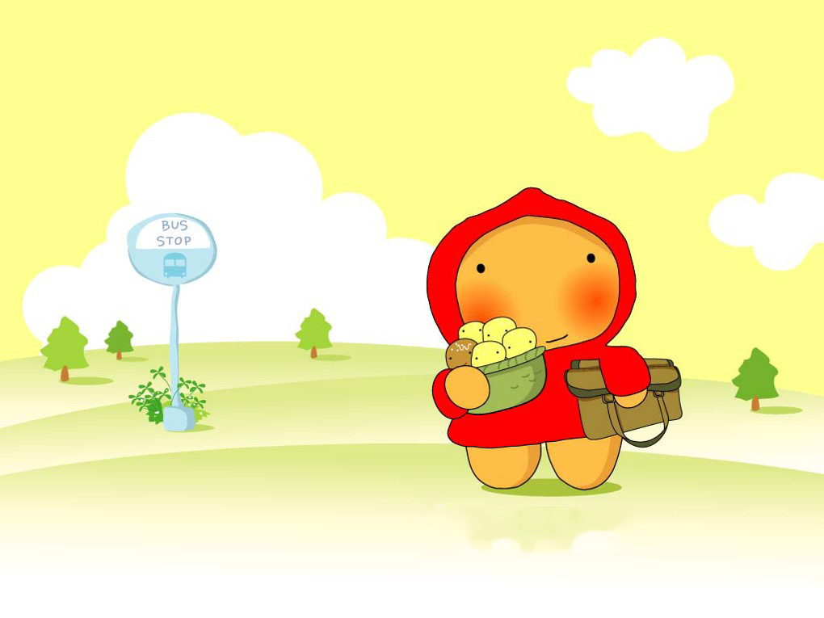
Unit 3 We all like PE!

Slide 2
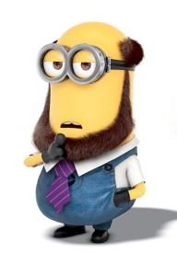

I like PE.
It’s easy and fun.

Slide 3
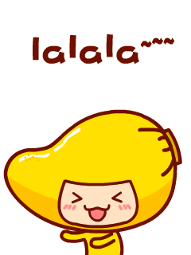
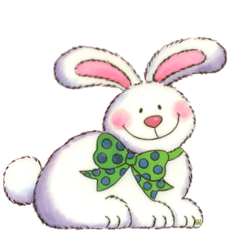
I like music.
It’s easy and fun.

Slide 4


I like Chinese .

Slide 5
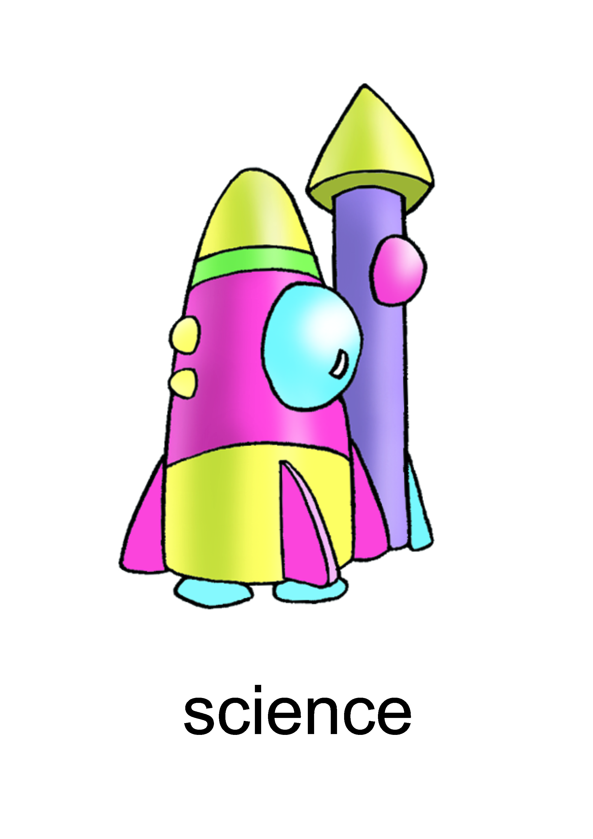

I like science.

Slide 6
Thank you!

